Slide 1
COMPUTER FUNDAMENTALS
.
A 1.1 .6 COMPUTER HARDWARE AND OPERATIONS

Slide 2
A 1.1.1 The CPU
Inquiry Statement : Describe the process of pipelining in multi-core architectures. (HL only)
Skills
Students will be able to analyse the flow of instructions through a pipeline and identify potential hazards.
Students will be able to evaluate the impact of pipelining on instruction throughput and execution time.
Students will be able to explain the advantages of multi-core processors for multitasking and parallel processing.
ATL (Approaches to Learning) Skills
Communication: Students will effectively communicate their understanding of pipelining and multi-core architectures through discussions, presentations, and written explanations.
Collaboration: Students will work collaboratively in groups to analyze diagrams, solve problems, and complete activities related to pipelining.
Critical Thinking: Students will analyze the benefits and challenges of pipelining, evaluate its impact on CPU performance, and apply their knowledge to optimize instruction execution.
Information Literacy: Students will effectively use online resources and research to deepen their understanding of pipelining and multi-core architectures.

Slide 3


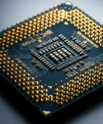


Do Now Activity (5 mins)
Identify the and explain the
Components of Computer
TOK
To what extent can data manipulation be considered an objective process when human judgment influences how databases are designed and interpreted?
Success Criteria:
Students will be able to analyse the flow of instructions through a pipeline and identify potential hazards.
Students will be able to evaluate the impact of pipelining on instruction throughput and execution time.
Students will be able to explain the advantages of multi-core processors for multitasking and parallel processing.
Learning Intention:
Describe the process of pipelining in multi-core architectures.

Slide 4
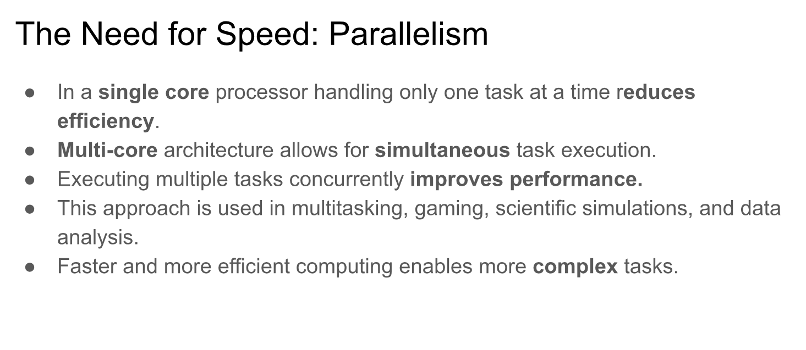

Slide 5
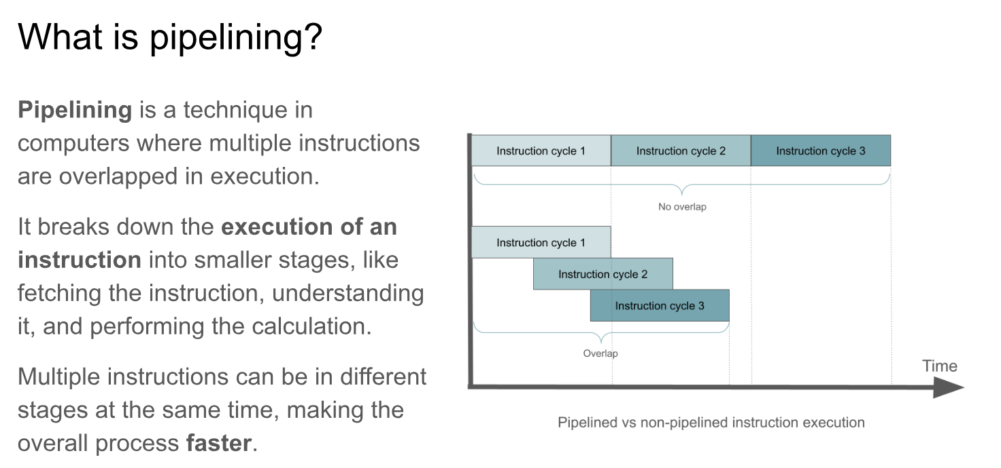

Slide 6
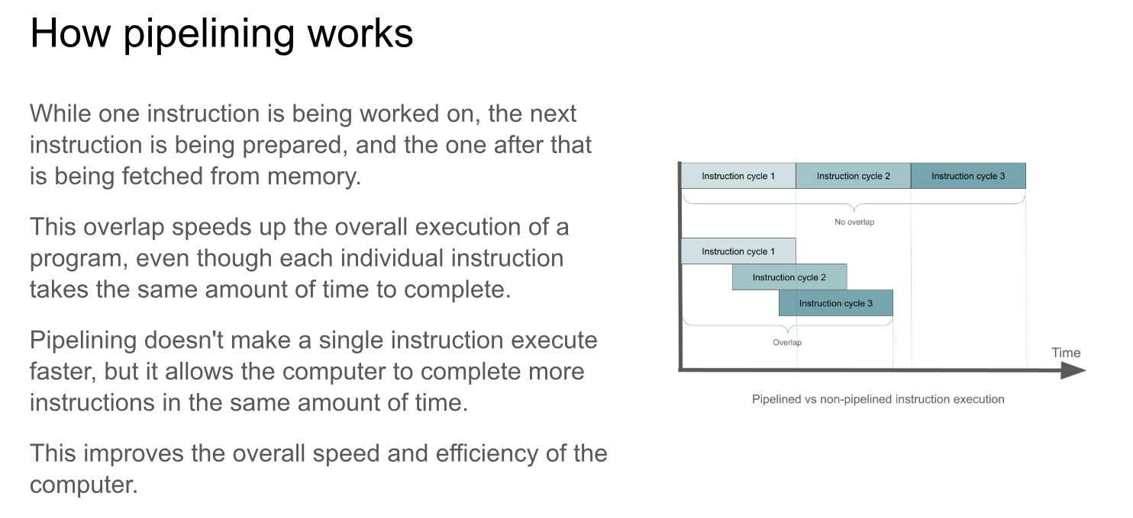

Slide 7
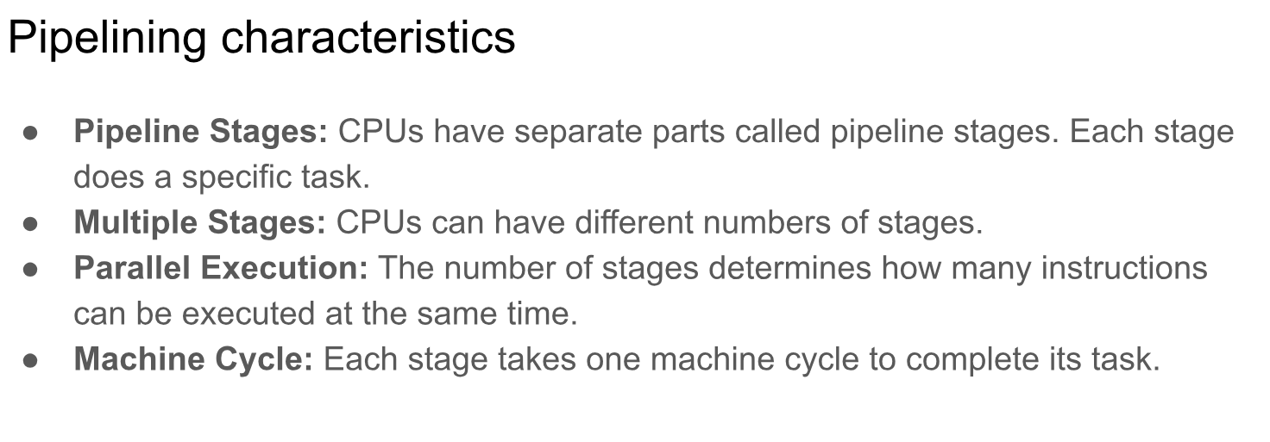

Slide 8
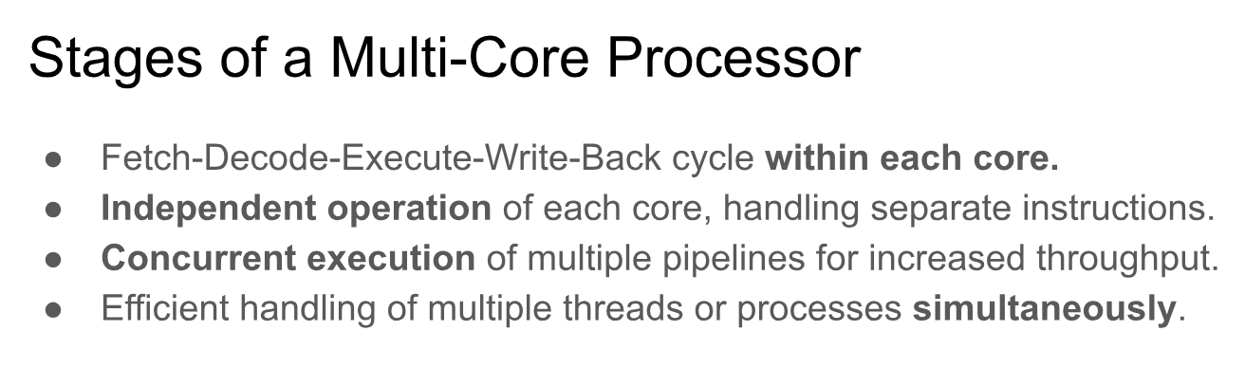

Slide 9
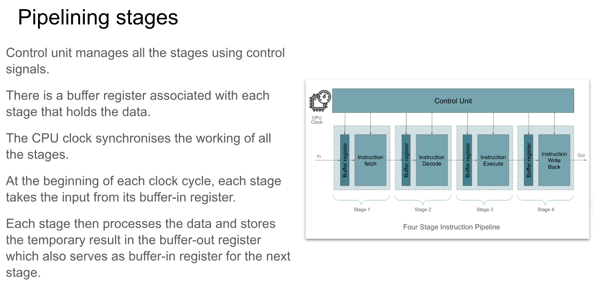

Slide 10
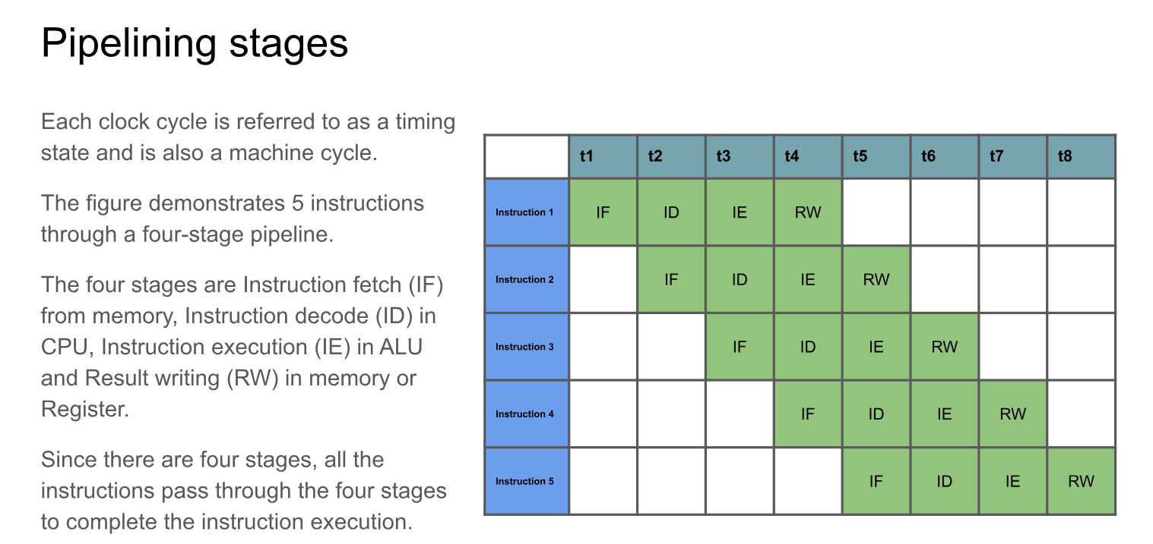

Slide 11
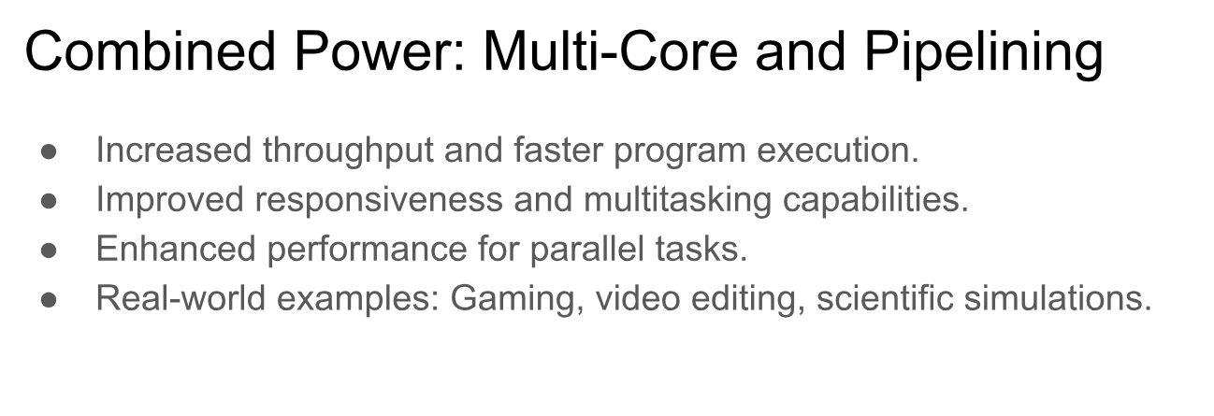

Slide 12
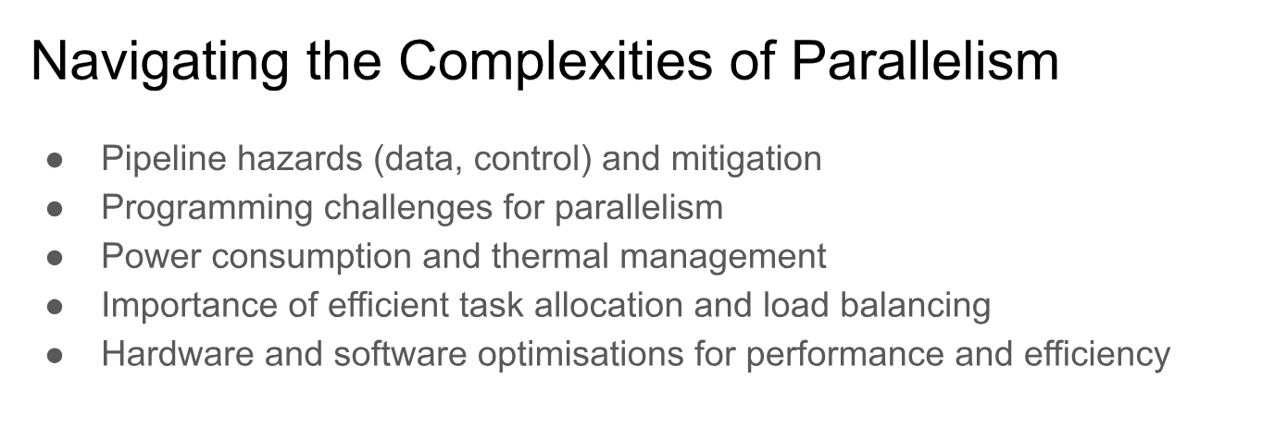

Slide 13
GROUP TASK
LEVEL 1 : Table 1
Create a mind map explaining the purpose of using pipelining
LEVEL 2 : Table 2
Create a mind map explaining the future trends for Computer hardware
LEVEL 1 : Table 3/4
Create a PPT explain the working of Pipelining

Slide 14
Evaluate (5 minutes)
Students will be able to explain the concept of pipelining and how it improves CPU performance.
Students will be able to describe the four stages of pipelining (fetch, decode, execute, write-back) and their functions.
Students will be able to explain how pipelining works in multi-core architectures, where each core has its own pipeline.
Students will be able to describe how cores in multi-core processors operate independently and in parallel.

Slide 15
Extension Activities:
"Parallel Programming Challenge": Introduce students to basic parallel programming concepts and have them write a simple program that utilizes multiple cores.
"Research Current CPU Architectures": Students Research the latest CPU architectures from companies like Intel and AMD, focusing on how they implement pipelining and multi-core processing to achieve high performance.

